Slide 1
Zuckflix Recommendation
Nicolas Forcade-Perkins

Slide 2
Focus of Recommendations
How much content should we add?
When should we add the content?
What tv shows and movies should we add?
Will focus on overall catalog and a US-specific catalog
Notes:
Intro slide that will focus on what I am going to be basing my recommendations on

Slide 3
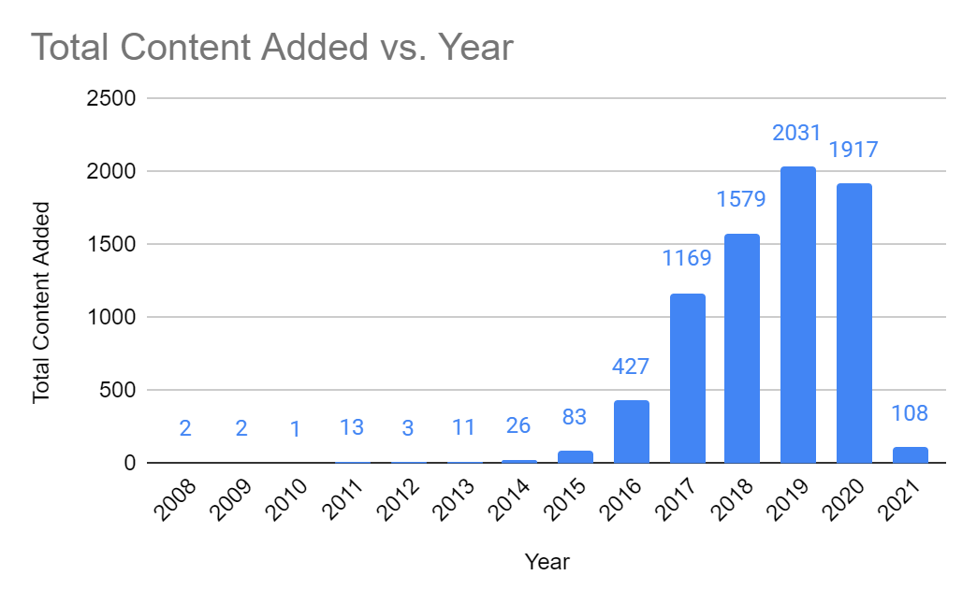
The Data
Netflix data dating back to 2008
7381 total data points
Contains information about the content:
Genre
Release year
Director
Cast
Etc.

Slide 4
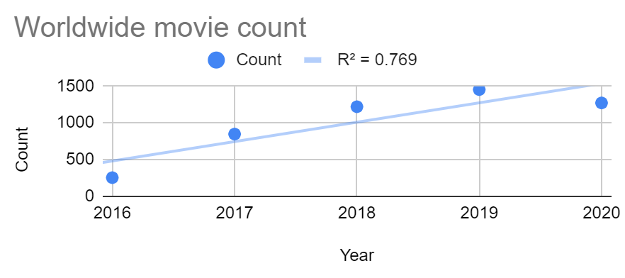
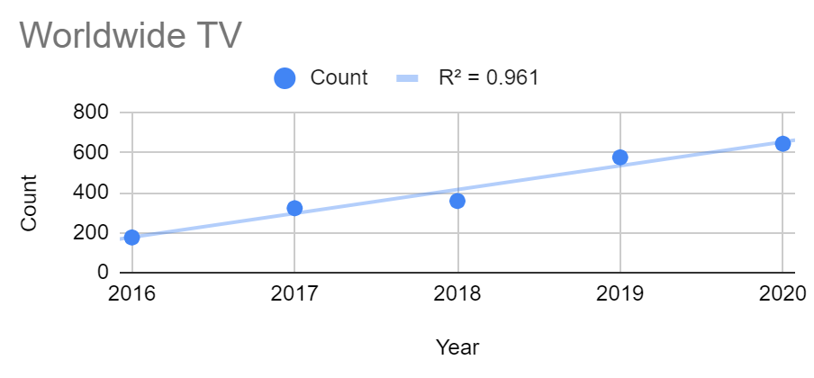
How much content to add
Used a linear regression
r² ranging from .77 to .98
Amount of content added has been growing linearly over past five years
Used a line of best fit in order to predict how much content will be added in 2022
*r² is a measure of how well the points fit the line. Closer to 1 (or -1) is better
Notes:
Make note of how the other line graphs were very similar. Is this slide too busy?
Make note of how proportion of tv to movies has remained very constant.

Slide 5
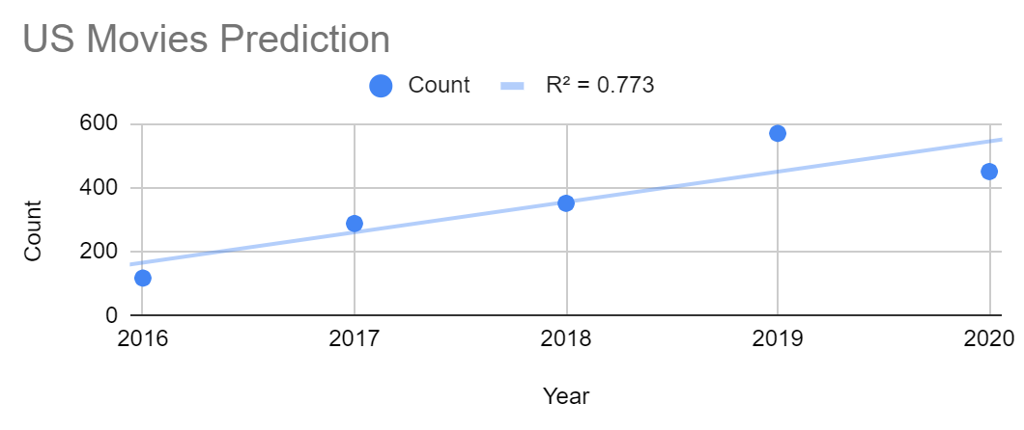
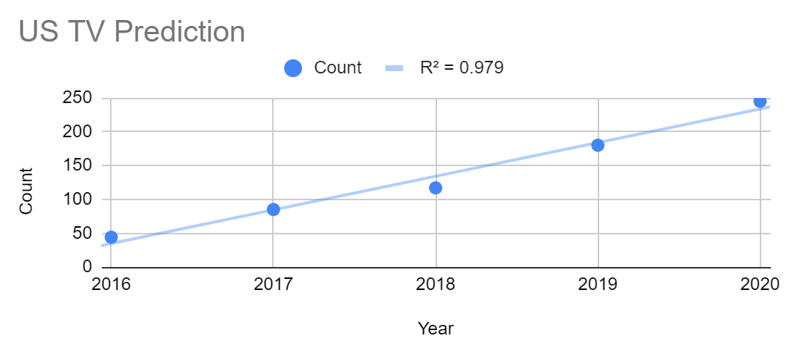
How much content to add cont.
Worldwide Movie = 1,666 added in 2022
Worldwide TV shows = 891
US Movie = 733
US TV shows = 333

Slide 6
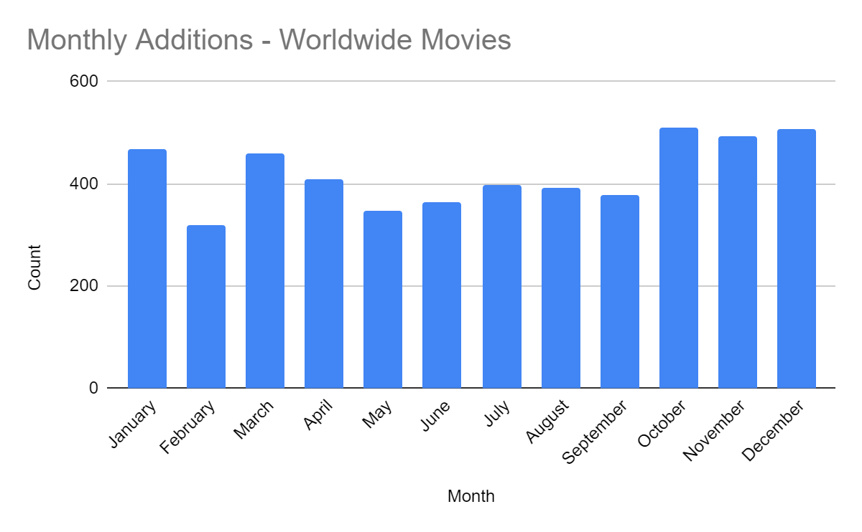
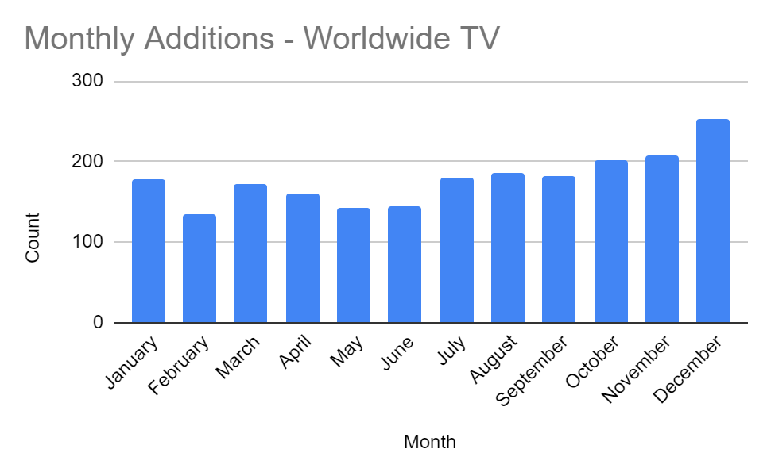
When to add our content
Notes:
Netflix adds the most movies/TV shows between the months of Oct and Jan. Both in their overall catalog and the US specific catalog. FIts with the idea that people and families watch the most tv during these months as it is frigid outside and there isn’t anything to do compared to the summer months. Want the most new content added when people are at their eagerest to watch

Slide 7
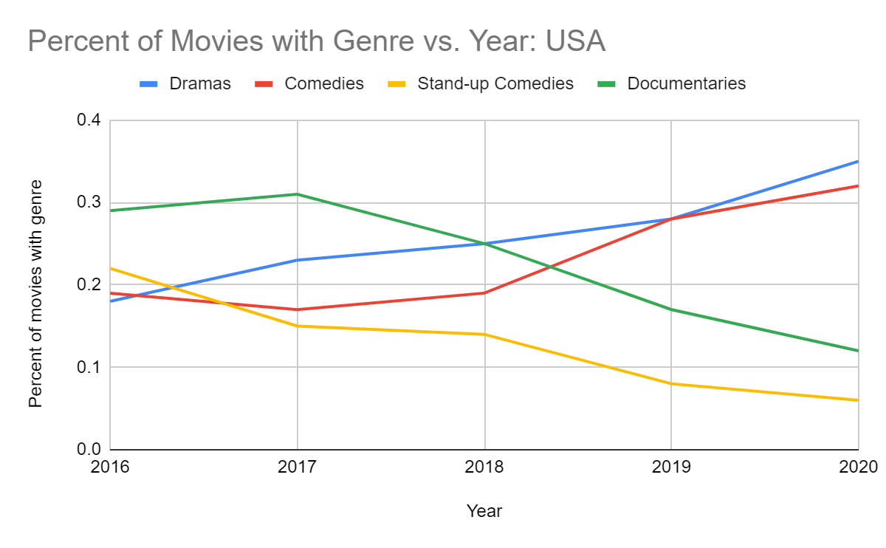
What shows and movies to add
Comedies and Dramas trending up
Top 3 genre listed in all breakdowns
Same trend for TV shows in US
Notes:
Want dramas and comedies! Ranked in the top 3 genres listed across WW movies, tv and US movies and tv.
Want about 50% of overall content to be Intl’ movies or Tv shows
Want new movies

Slide 8
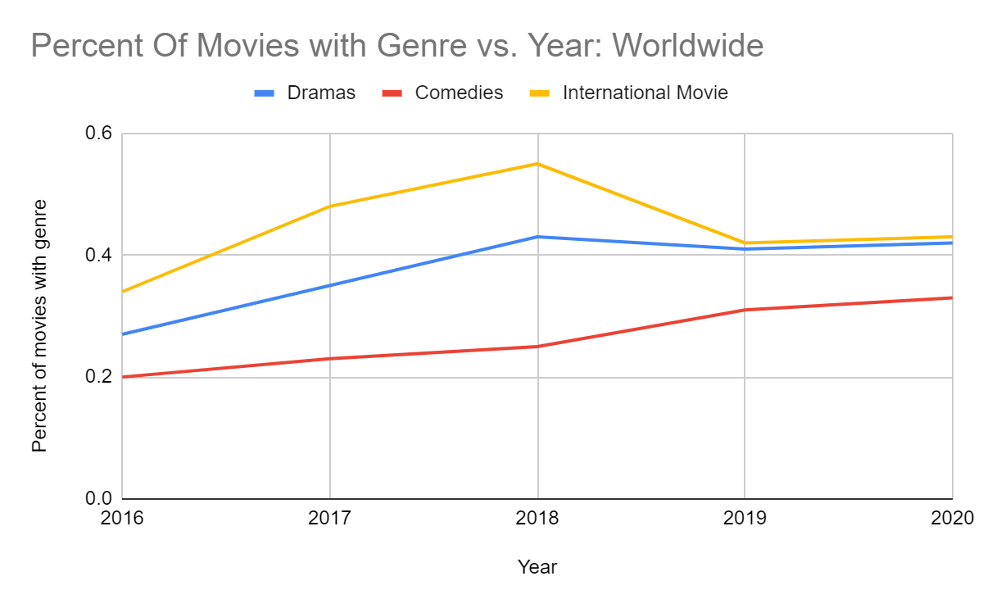
What shows and movies to add cont.
Want about 40% of overall catalog to be international
Same genres are still popular
Same trend for TV shows worldwide

Slide 9
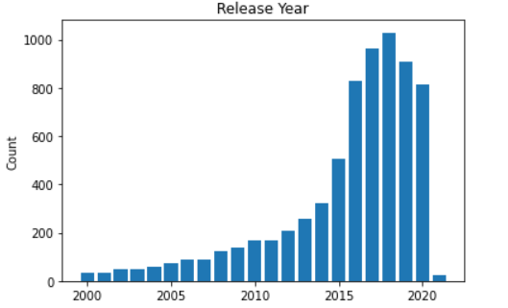
What shows and movies to add cont.
Want new content
50% of all content added was added within a year of its release date

Slide 10
Thank you!
Notes:
Thank Nanyi and Juan for their input, and the recruiters for giving me the opportunity to participate in this challenge. I had a great time and learned a lot

